Slide 1


IMechE 2017 Challenge
Lucas Wetzel
Andrew Udoh
Marlon gwira

Slide 2
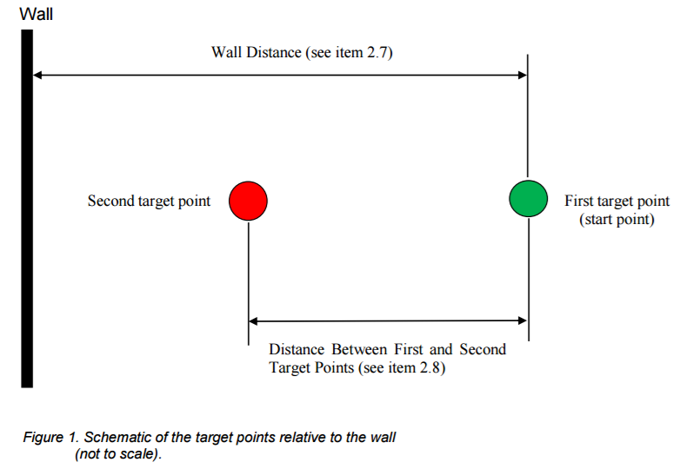
The Challenge
The challenge was, the device starts on the first target then moves to the wall then back to the first target. The device then stops for 5 to 10 seconds, then it moves to the second target, which the distance is given on the day.

Slide 3
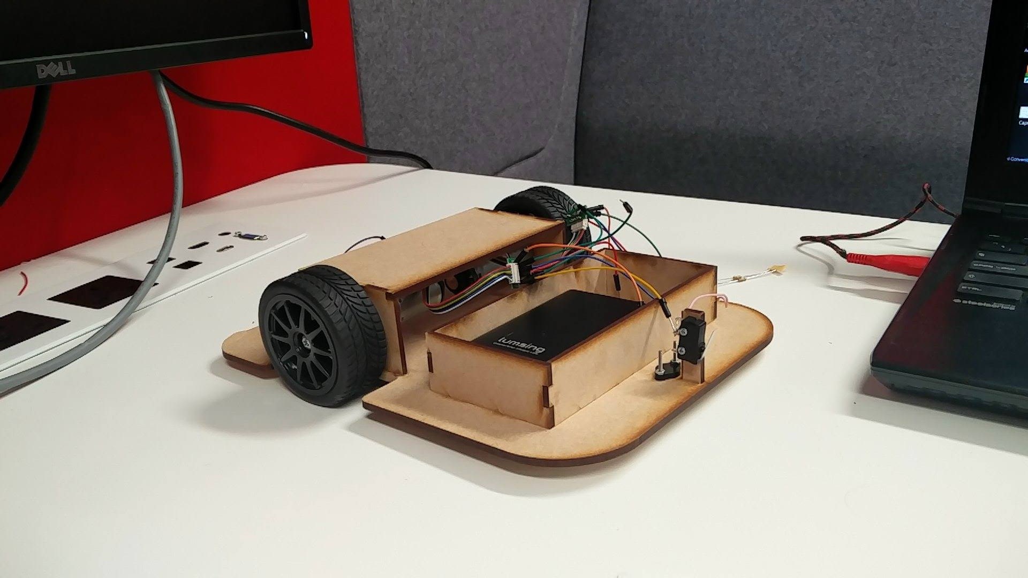
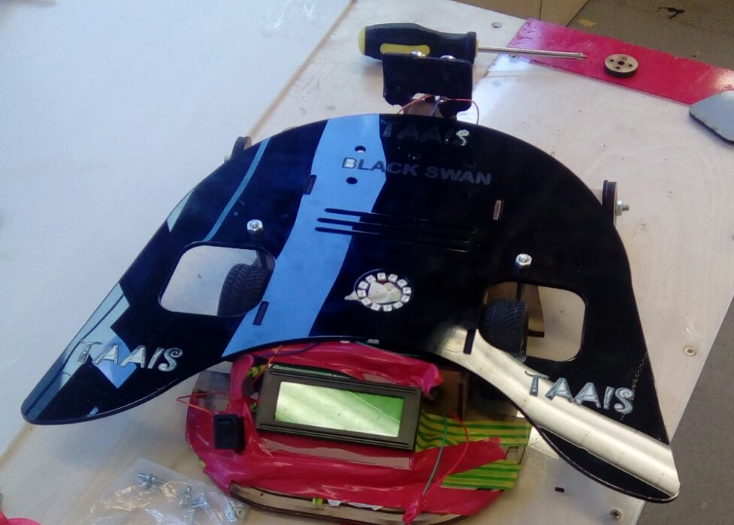
Prototypes
Pros
Simple
Cheap
Met specifications
Cons
Wheels were wobbly
Didn’t work
Pros
Unique design
Complex circuitry
Cons
Couldn't achieve a straight line

Slide 4
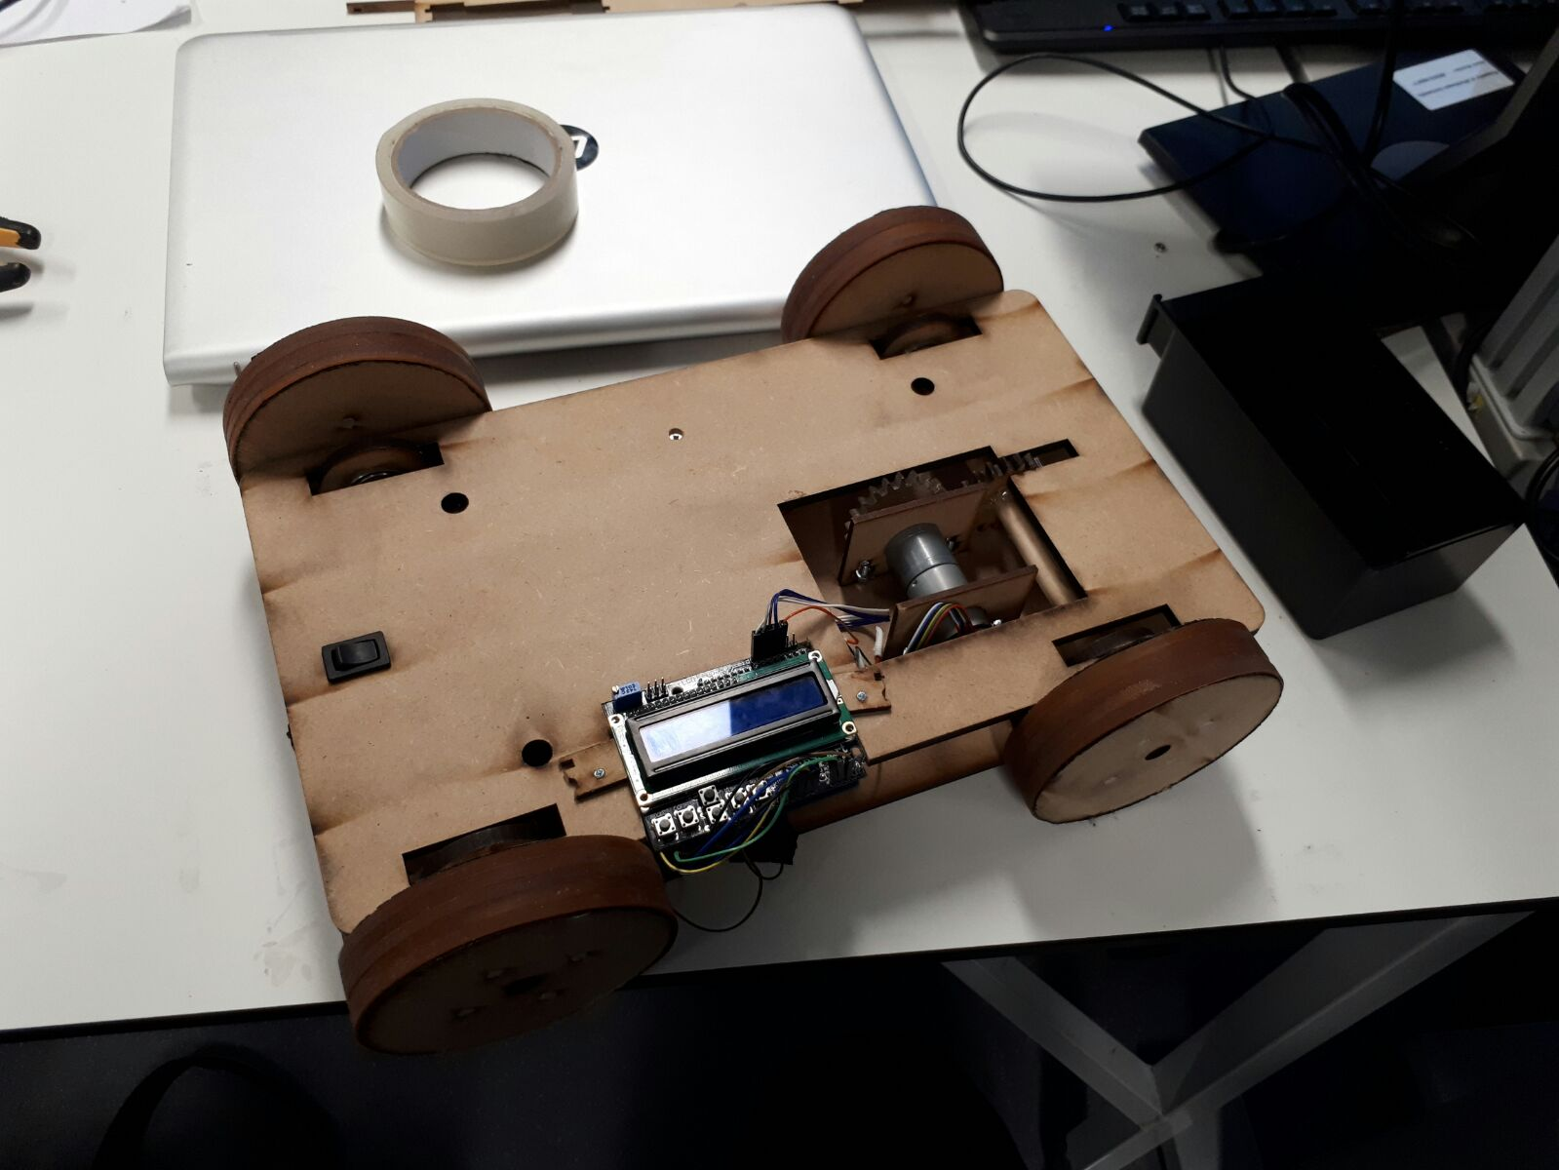
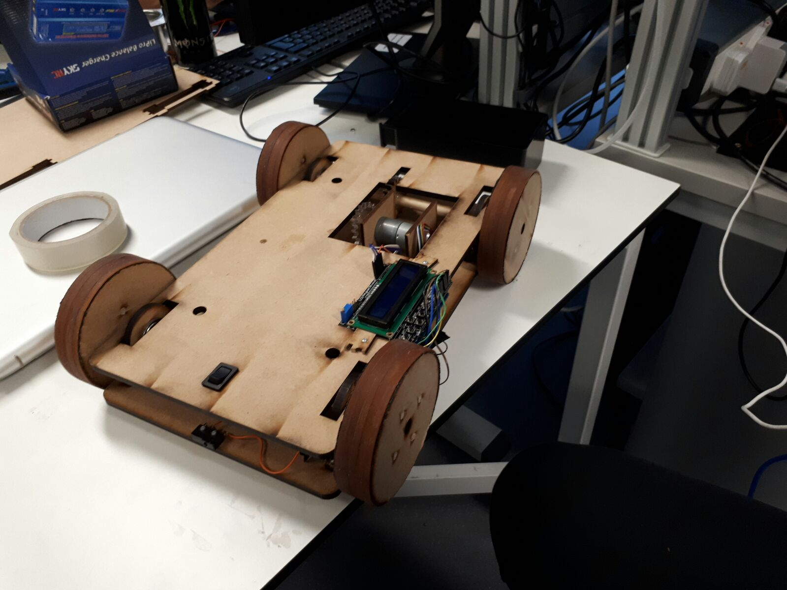
Final Design
Arduino with a LCD display
1x DC motor
1x H-Bridge
1x Battery pack
1x Switch
1x Bump switch
1x Encoder counter
4x Self made wooden wheels with rubber tires

Slide 5
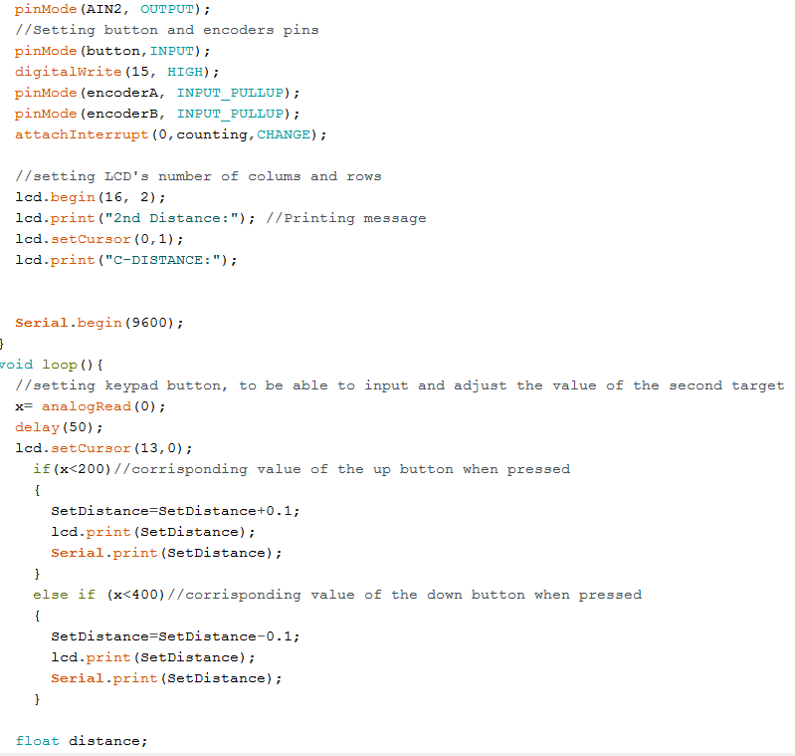
Code

Slide 6
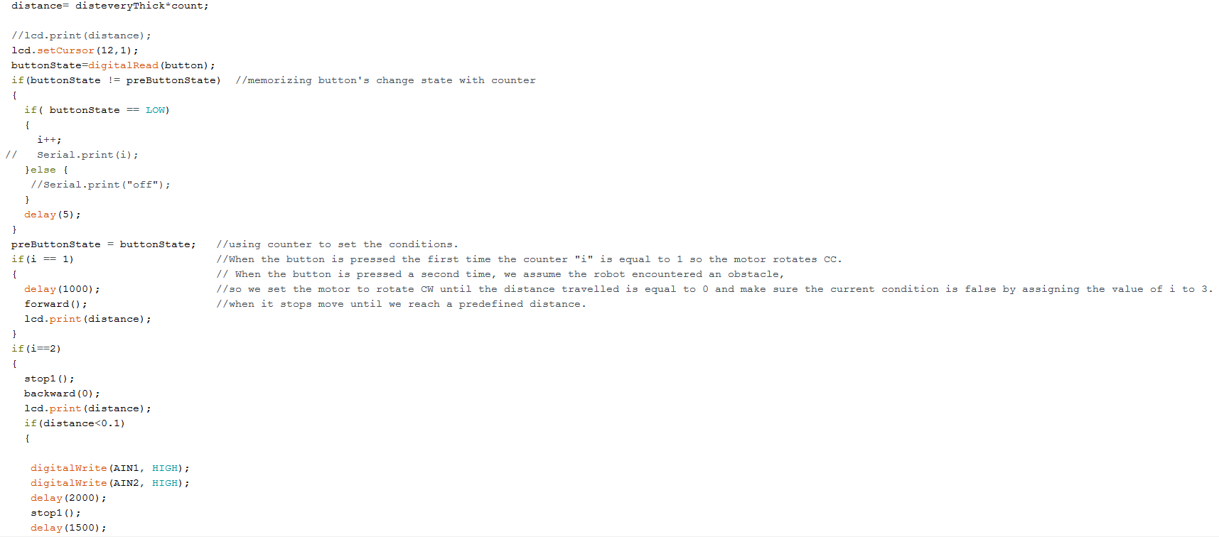

Slide 7
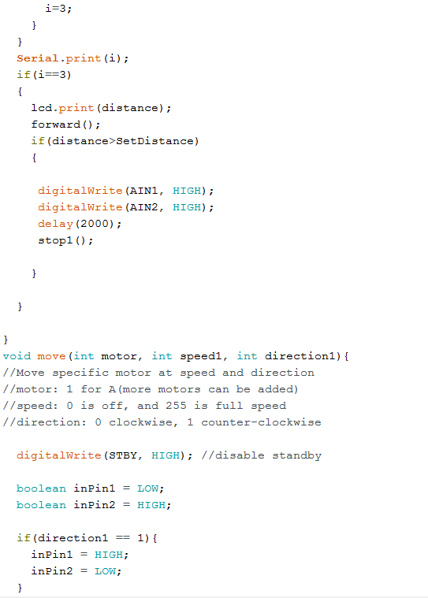
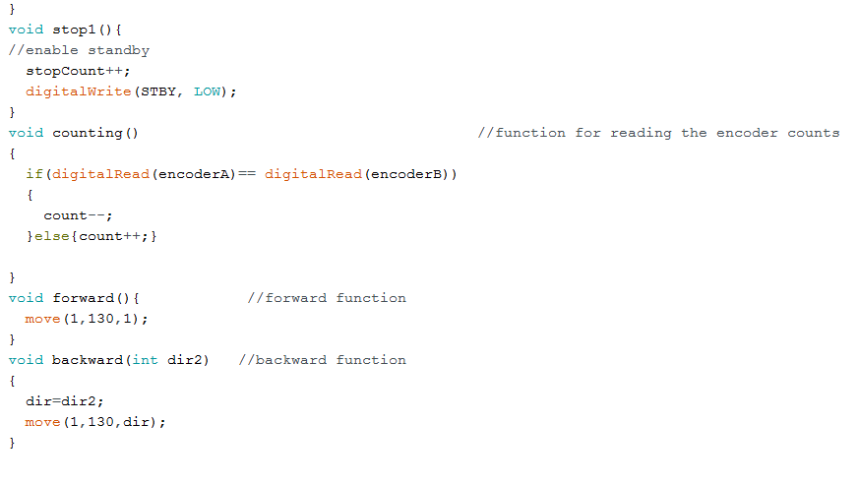

Slide 8
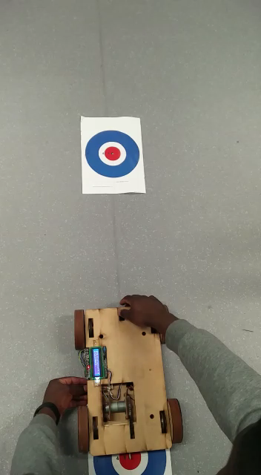
Live Demo

Slide 9
Future developments
Improvement on team work
Better time management
A more stable motor
Better care on aligning bearings and gears
Better material management

Slide 10
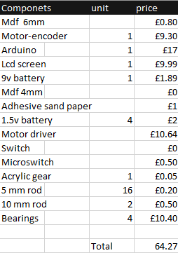
Costs

Slide 11
Thanks for listening Do you have any questions?

